Slide 1

Transient simulation of a windowless spallation target with Armando Luca Massidda CRS4 2nd THINS Cluster Workshop in Stockholm, Feb. 6-7, 2013

Slide 2

TOC
Overview of the SPH method
A short description of the implementation
The GPU version of the code
The application to a free surface liquid target
Slow transient analysis of free surface dynamics and stability
Fast transient analysis of shock waves
Conclusions

Slide 3
The method
The idea at the basis of the method is that any function can be approximated as:
W is the kernel function, h is the smoothing length.
The portion of space occupied by a material is discretized as a set of np particles of given mass, position, velocity, density and internal energy.
The integral above may be rewritten in discrete form as:
where f_{i} = f(x_{i}) and W_{ij}=W(x_{i} – xj, h).
The spatial derivatives of the function are obtained similarly by deriving the kernel function:

Slide 4
The kernel function
The kernel function W is a smooth and differentiable function of the inter-particle distance and of the characteristic length h
It has a compact support and approximates the Dirac function as h approaches zero, so that it has a unit integral over the domain.
A simple kernel function is the Gaussian
The functions adopted are similar but allow a faster computation
Since the kernel function rapidly decreases to zero with r, the previous sums may be limited to the particles whose distance from the one of interest is lower than a cut-off value proportional to the smoothing length
r
h

Slide 5
Navier-Stokes approximation
The method is used to approximate the Navier-Stokes equations.
The expressions of the Lagrangian time derivative of density, velocity and internal energy are:
The method has to be closed by an equation of state that relates the pressure to the density and internal energy of a material

Slide 6
Implementation
The method adopts an explicit time integration with three steps.
The single time step may be divided in four phases
Find the neighbors for each particle
Calculate particle interactions
Calculate the equation of state
Particle update
Initial state
Neighbor
list
Particle
interactions
EOS
Particle
update
3x
Final state
T += ΔT
Save
state

Slide 7
Neighbor list
The neighbor list update consists in finding the set of n_{n} particles whose distance is lower than the chosen cutoff value
A space sorting technique is adopted:
Space is divided by a cartesian grid
Particles are ordered for their cell index
A hash table is created on the cell index
For each particle the search for neighbors is limited to particle falling in the surrounding cells
A connectivity double array (n_{p}, n_{n}) is created
2h

Slide 8
Particle interaction and update
This is the most time consuming part of the algorithm, due to the numerical complexity.
Each particle scans the neighbor list and performs the sums of the NS approximations, a double cycle on the CPU is required
The time derivatives of density, velocity and internal energy are computed
The new values of particle density, energy, velocity and position are calculated
The updated value of the pressure is calculated for each particle by the EOS
The loop is completed
2h

Slide 9
SPH pros and cons
PROs
The method is simple and allows to deal with a wide range of transient physical phenomena.
It is a mesh less method, all the boring meshing process is avoided
It is particularly suitable for the simulation of free surface liquids and fast transients such as explosions with phase changes.
CONS
It is numerically complex due to the large number of connections each particle has with its neighbours
and to the necessity to recalculate the neighbor list at each time step
A huge number of particles may be required due to the constant particle size adopted
Boundary conditions may be tricky

Slide 10
GPUs pros and cons
In the past years GPUs have gained an important role in high performance computing
PROs
have impressive computing power at very accessible costs
ease of maintenance, when compared to a computer cluster
low power consumption
CONS
it is a massively parallel architecture, the developer has to think differently
not as easy to program and debug as CPUs
It is not possible to simply port an application on the GPU, is performance is a must, the application has to be almost entirely rewritten and the algorithm modified
Not all applications are suitable for GPUs!

Slide 11
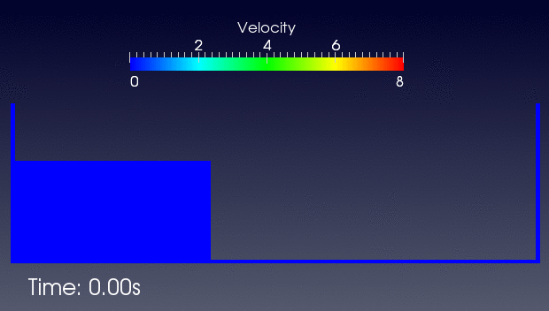
SPH on GPU
Once the algorithm is modified and rewritten for the GPU the results may be impressive
The poor performance of the method on the CPU is no longer an issue
An Intel Xeon at 2.67GHz and an nVidia Tesla C1060 is used for the tests
Dam break | Test 1 | Test 2 | Test 3
Particles | 6462 | 22899 | 85773
Time steps | 10000 | 20000 | 40000
CPU time | 15m 26s | 106m 44s | 784m
GPU time | 19s | 1m 21s | 8m 34s
Speedup | 48 | 79 | 91

Slide 12
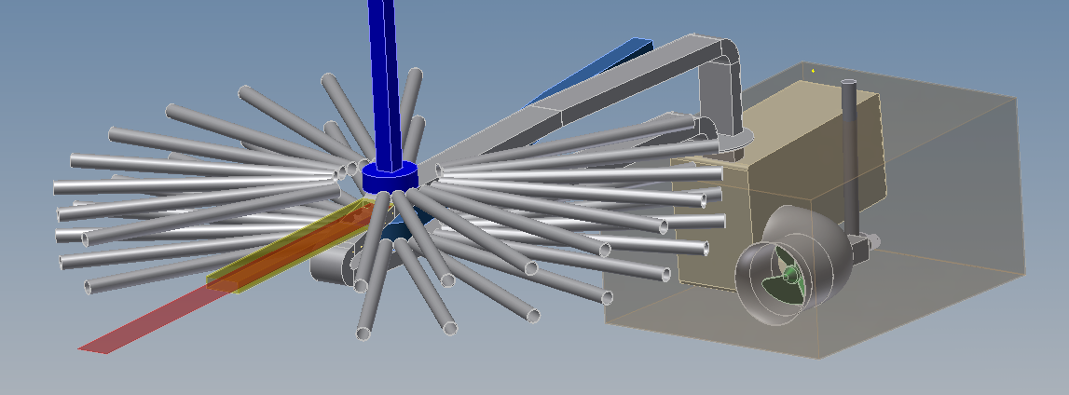
A free surface target analysis
The accelerated version of the SPH code has been applied to the analysis of a liquid metal in order to
Test the potential of the code
Define and verify the simulation techniques that may be adopted
We used as a reference the free surface concept for the Euopean Spallation Source that has been recently developed by KIT

Slide 13
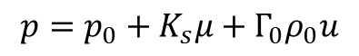
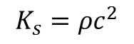
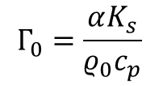
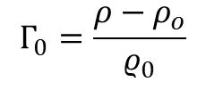
Load conditions and material properties
ESS facility aims at producing high energy spallation neutrons, by the interaction of a pulsed high energy proton beam with an appropriate target material
Liquid target has been considered as an option for the design and a free surface concept has been proposed by KIT
The long pulse duration and the free surface allow to attenuate the pressure waves that are generated due to the sudden beam power deposition
The following EOS for LBE is adopted
Beam properties
Proton energy | 2.5 GeV
Mean current | 2 mA
Beam power | 5 MW
Pulse frequency | 20 Hz
Power on target | 2.3 MW
Property (1atm) | LBE
Density [kg/m3] | 10338
Std. Weight [g/mol] | 208.2
Melting point [K] | 397.7
Boiling point [K] | 1943
Heat cap. [J/mol K] | 30.8
Vapor pr. @700K [Pa] | 10⁻⁴
Sound velocity [m/s] | 1774
Thermal exp. [μ/mK] | 123

Slide 14
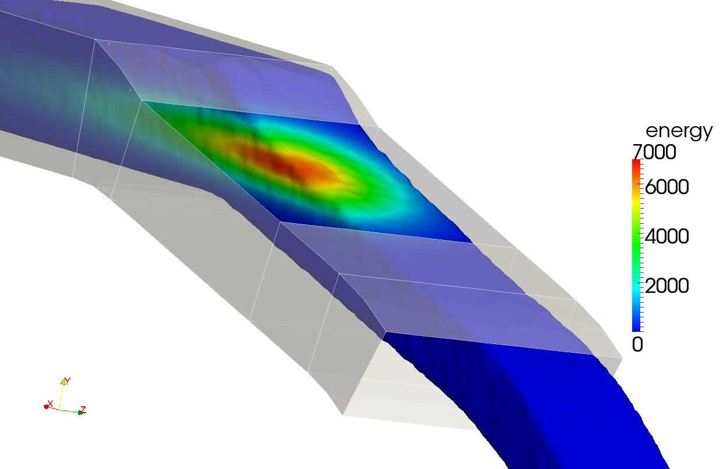
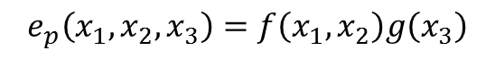
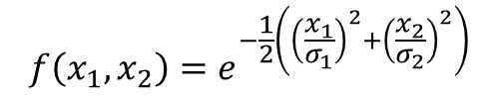
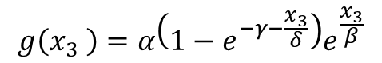
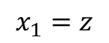
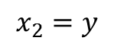
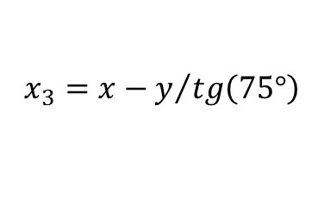
Load conditions and material properties
Beam power deposition has been evaluated through neutronics and was approximated with the expressions:
The following coordinate transformation has been applied to include the effect of the oblique beam impact on the free surface
Channel properties
Width | 220 mm
Inlet height | 110 mm
Nozzle height | 85 mm
Window length | 235 mm
Flow vel. In nozzle | 2 m/s

Slide 15

Simulation setup – slow transients
The transient simulations are run on a Tesla C1060 GPU
The material properties for slow transients without pressure waves are modified with respect to standard values
The particle number varies during simulation, around 1million particles are used with a GPU occupancy < 1GB
Model properties
Particle diameter | d | 4 mm
Smooth length | h | 4.8 mm
Density | ρ | 10338 kg/m3
Speed of sound | c | 17.4 m/s
Gruneisen par. | Γ | 0
Time step | Δt | 200 μs

Slide 16
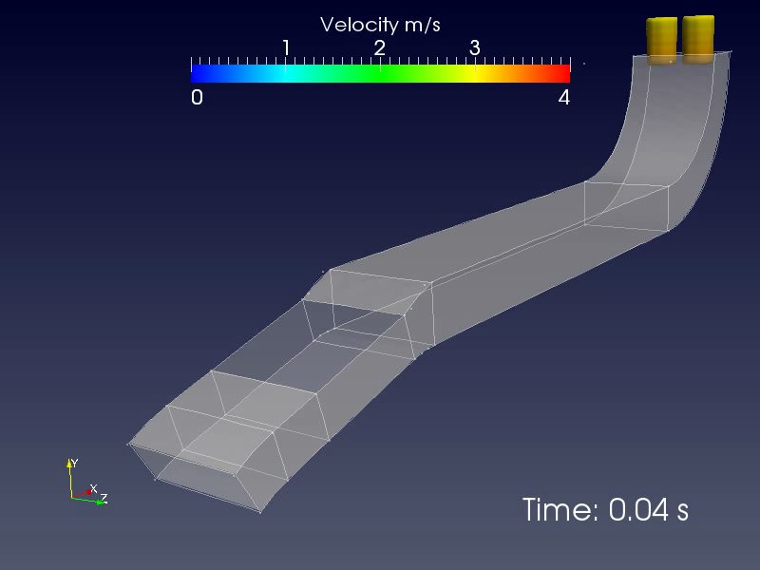
Filling the channel

Slide 17
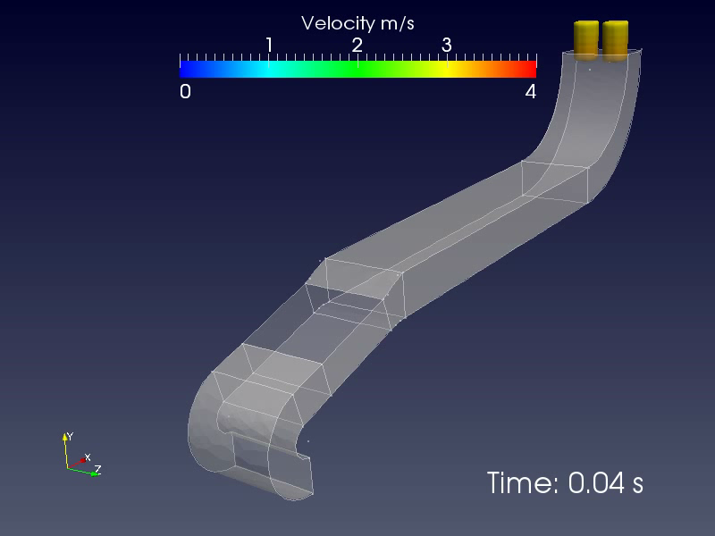
Channel outlet

Slide 18
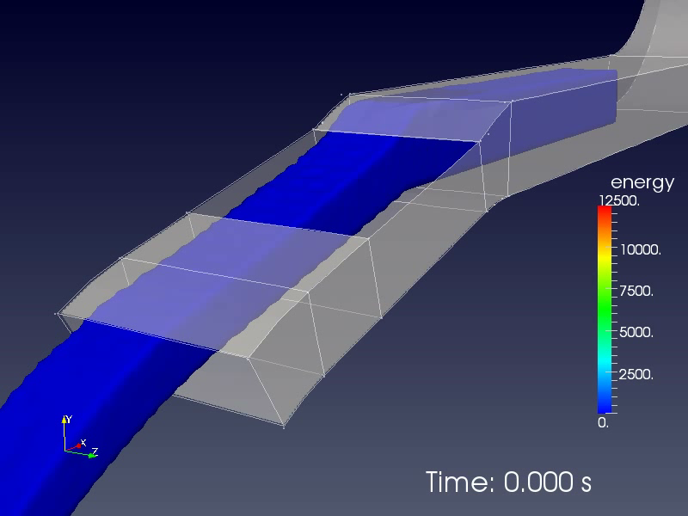
Target heating

Slide 19
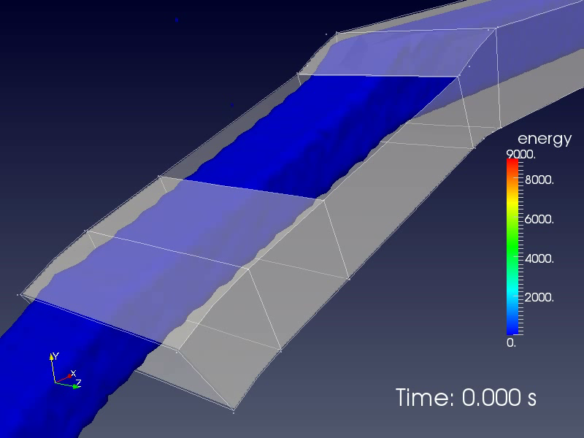
Target heating, double mass flow rate

Slide 20
Simulation setup – slow transients
The correct values of the material properties are adopted
The time step reduces as well as the maximum simulation time
4 beam hits are analyzed to check the beam power superposition effects
Model properties
Particle diameter | d | 4 mm
Smooth length | h | 4.8 mm
Density | ρ | 10338 kg/m3
Speed of sound | c | 1740 m/s
Gruneisen par. | Γ | 2.6
Time step | Δt | 2 μs

Slide 21
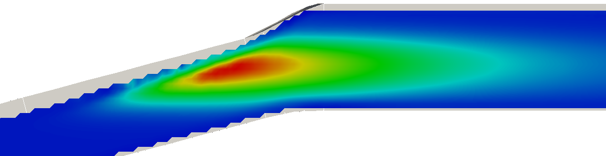
Pressure variation
The pressure wave variation inside the channel is characterized by multiple reflections and a really complex pattern
The maximum pressure follows the energy deposition profile with positive pressure wave departing at the beginning of the beam deposition and negative pressure wave at the end.

Slide 22
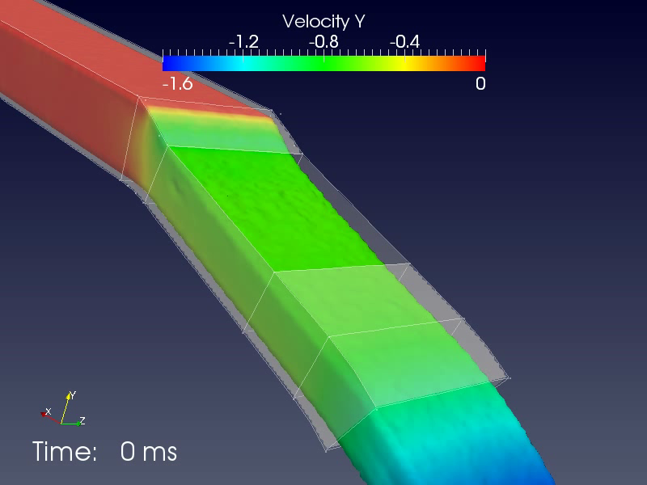
Shock waves, design conditions

Slide 23
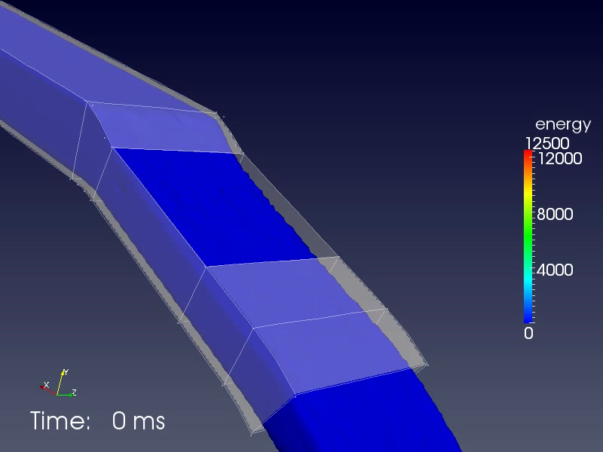
Splashing, short pulse

Slide 24
Conclusions
The SPH code Armando has been successfully rewritten for the GPU architecture
A significant advantage has been obtained from the new architecture, with speedups with respect to the CPU version higher than 60x
Analyses that had to be limited in length and accuracy due to the computational requirement can now be run on a desktop pc with an acceleration card
The code allows to simulate slow and fast transients for free surface flows with beam interaction
The analysis procedure has been setup and applied to a free surface target concept
Thanks for the attention!
Any question is more than welcome

